Slide 1
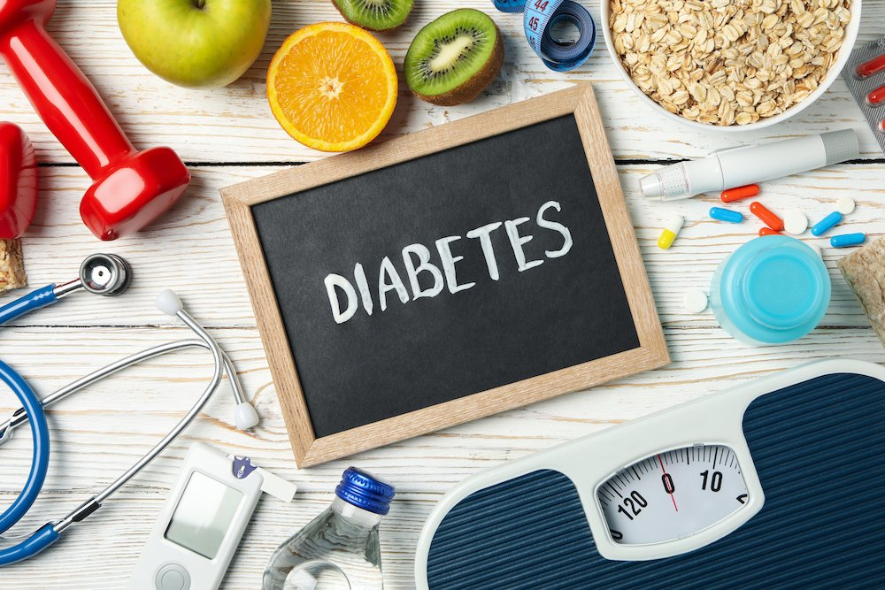
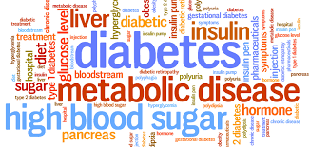
DIABETES DETECTION
ARAVINDA RAMAN J
DATA SCIENCE AND ML INTERN
EXPOSYS DATA LABS
E-mail: aravindaraman04@gmail.com

Slide 2
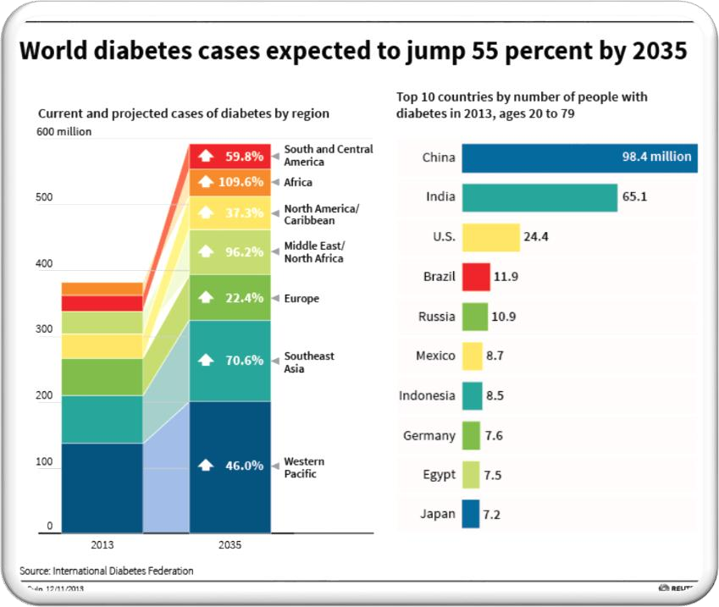
INTRODUCTION
Diabetes is a disease that occurs when your blood glucose, also called blood sugar, is too high. Blood glucose is your main source of energy and comes from the food you eat.
Insulin, a hormone made by the pancreas, helps glucose from food get into your cells to be used for energy. Sometimes your body doesn’t make enough—or any—insulin or doesn’t use insulin well. Glucose then stays in your blood and doesn’t reach your cells.
Over time, having too much glucose in your blood can cause health problems. Although diabetes has no cure, you can take steps to manage your diabetes and stay healthy.
Diabetes is also creator of different kinds of diseases like heart attack, blindness etc.. The normal identifying process is that the patients need to visit a diagnostic center, consult a doctor and sit tight for a day or more to get their reports
Cause of diabetes vary depending on the genetic makeup, family history, ethnicity, health etc..
Diabetes & pre-diabetes is diagnosed by blood test.

Slide 3
STANDARD PROCESS: CRISP DM
Crisp DM process is used to better understand the problem and give us better insight of whole process.
CRISP DM(Cross Industry Standard Process For Data Mining) has six phases:
1. Business/Research Understanding Phase
Determine the business objectives
To assess the problem and determine data mining goals
To come up with a strategy to meet goals and objectives
2. Data Understanding Phase
Collect the data
Assess and analyse the data

Slide 4
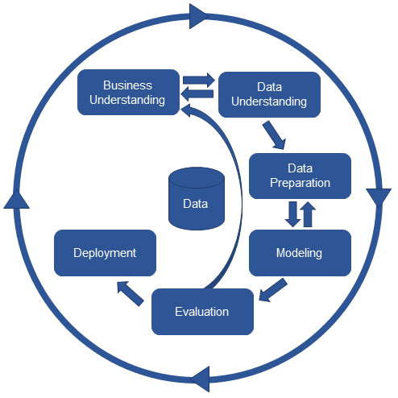
STANDARD PROCESS:CRISP DM
3. Data Preparation Phase
Clean the data i.e. remove any missing values or outliers etc.
Transform the data
Select specific data for analysis
4. Modeling
Select appropriate data modelling technique
5. Evaluation
Evaluate the model
Calculate the accuracy and success rate of the model
6. Deployment
Plan deployment
Monitor Deployment
Generate reports to test success of the model

Slide 5
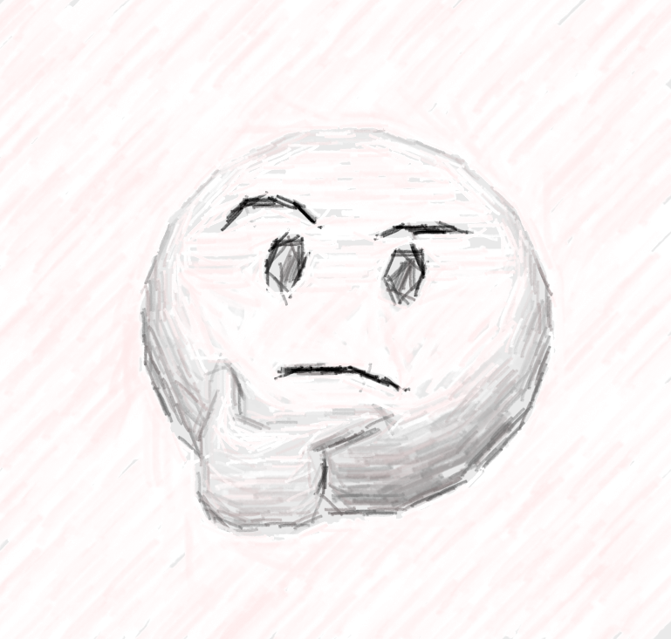
BUSINESS UNDERSTANDING
What is the profound question?
To identify whether the patient is having diabetes or not?
Goal
Goal of this project is to identify the probability of diabetes in patients using data mining techniques.
Advantage of this project
The rules derived will be helpful for doctors to identify patients suffering from diabetes. Further predicting the disease early leads to treating the patient before it becomes critical.

Slide 6
DATA UNDERSTANDING
Data Source
This dataset is originally from the National Institute of Diabetes and Digestive and Kidney Diseases. The objective is to predict based on diagnostic measurements whether a patient has diabetes or not.
This dataset has 769 samples of diabetic and healthy individuals.
In particular, all patients here are females of at least 21 years of age.
The diabetes dataset is credited to UCI machine learning database repository.

Slide 7
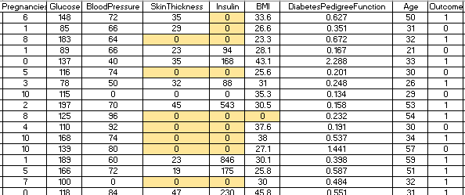
DATA UNDERSTANDING
 Data Set Details:
The dataset consist of 769 samples, out of which 500 are non diabetic while 269 are diabetic people.
All patients are females of at least 21years of age.
The dataset has total 9 attributes out of which 8 are independent variables and one is the dependent variable i.e. target variable which determines whether patient is having diabetes or not.
 Sample Data

Slide 8
DATA UNDERSTANDING
Attributes Details:
Pregnancies: No. of times pregnant
Glucose: Plasma Glucose Concentration a 2 hour in an oral glucose tolerance test (mg/dl)
Plasma Glucose Test | Normal | Prediabetes | Diabetes
2 hour post-prandial | Below 140 mg/dl | 140 to 199 mg/dl | 200 mg/dl or more
A 2-hour value between 140 and 200 mg/dL is called impaired glucose tolerance. This is called "pre- diabetes." It means you are at increased risk of developing diabetes over time. A glucose level of 200 mg/dL or higher is used to diagnose diabetes.
Blood Pressure: Diastolic Blood Pressure(mmHg)
If Diastolic B.P > 90 means High B.P (High Probability of Diabetes) Diastolic B.P < 60 means low B.P (Less Probability of Diabetes)

Slide 9
DATA UNDERSTANDING
Skin Thickness: Triceps Skin Fold Thickness (mm) –
A value used to estimate body fat. Normal Triceps Skinfold Thickness in women is 23mm.
Higher thickness leads to obesity and chances of diabetes increases.
Insulin: 2-Hour Serum Insulin (mu U/ml)
Feature | Normal Insulin Level
2 Hours After Glucose | 16-166 mIU/L
Values above this range can be alarming.
 BMI: Body Mass Index (weight in kg/ height in m²)
Body Mass Index of 18.5 to 25 is within the normal range
BMI between 25 and 30 then it falls within the overweight range.
A BMI of 30 or over falls within the obese range.

Slide 10
DATA UNDERSTANDING
Diabetes Pedigree Function:
It provides information about diabetes history in relatives and genetic relationship of those relatives with patients. Higher Pedigree Function means patient is more likely to have diabetes.
Age (in years)
Outcome:
Class Variable (0 or 1) where ‘0’ denotes patient is not having diabetes and ‘1’ denotes
patient having diabetes.
The dependent variable is whether the patient is having diabetes or not.

Slide 11
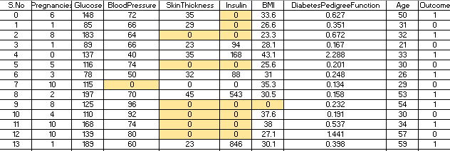
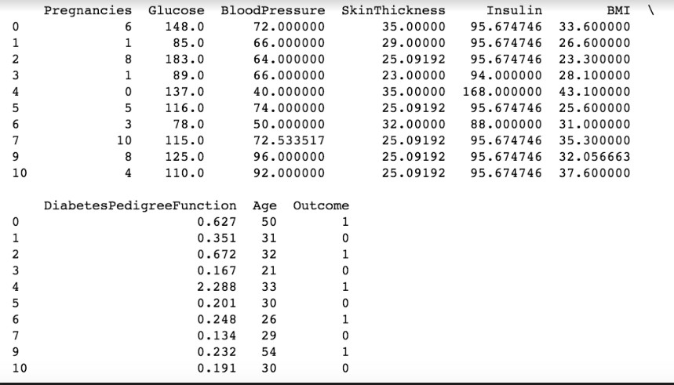
DATA PREPARATION
Data preparation stage includes data cleaning and transforming data if needed.
Various things have to be taken into consideration for data cleaning like:
Handling Zero/Null Values – The zeroes shown in the table are not zeroes but null values . We have deduced this based upon our inference that certain attributes like skin thickness, insulin, BMI etc cannot be zero.
The dataset had a lot of zero values.
The zero values have been replaced by the mean of that column.

Slide 12
DATA PREPARATION
Select appropriate attributes for analysis
The dataset consist of 9 attributes i.e. Pregnancies, Glucose, Blood Pressure, Diabetes Pedigree Function, Age, Skin Thickness, Insulin, BMI. These 8 are independent attributes and one i.e. Outcome is the dependent attribute.
As all these attributes affect diabetes so we decided to keep all the independent variables for data mining process.
Data Splitting:
Data was divided into training and testing data into 66.6:33.3 ratio. 2/3rd was training data and 1/3rd was testing data.

Slide 13
DATA PREPARATION
Different ranges were found out for each continuous variable in the data set. Based upon these ranges categorization was done.
The features were categorized as per the below mentioned ranges and
were denoted by 0,1, 2 & 3, in order to use them for classification.
Glucose
Plasma Glucose Test | Normal | Prediabetes | Diabetes
2 hour post-prandial | Below 140 mg/dl (0) | 140 to 199 mg/dl (1) | 200 mg/dl or more (2)
Blood Pressure(Diastolic)
Ranges | Low | Normal | High
 | Below 60 (0) | 60-90 (1) | 90 or more (2)
Skin Thickness
Ranges | Low | Normal | High
 | <23 (0) | 23 (1) | >23 (2)

Slide 14
DATA PREPARATION
Insulin
Ranges | Low | Normal | High
2 Hours After Glucose | <16 mIU/L (0) | 16-166 mIU/L (1) | >166 mIU/L (2)
BMI(weight in kg/ height in m²)
Ranges | Under-weight | Normal | Over-weight | Obese
 | <18.5 (0) | 18.5-25 (1) | 25-30 (2) | >30 (3)
Diabetes Pedigree Function
 | Low | Medium | High
 | 0-0.78 (0) | 0.79-1.561 (1) | >1.57 (2)
Age
Ranges | Young | Adult | Old
 | 20-44 (0) | 44-64 (1) | 64-100 (2)
No.of Pregnancies
Ranges | Normal | Above Normal | Highest
 | <6 (0) | 6-12 (1) | >12 (2)

Slide 15
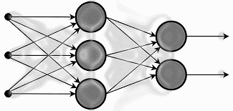
MODELING
This phase includes application of appropriate model to the data.
Machine Learning Algorithms were used for modeling.
As we have to classify the data into patients having diabetes or not, I have chosen K-nearest neighbors (KNN), Random decision forests and Artificial neural networks (ANN) to see which one provides us with the best accuracy.

Slide 16
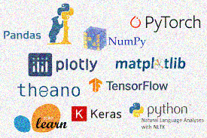
MODELING
 Software Used:
Python-Scikit Learn
Scikit-learn provides a range of supervised and unsupervised learning algorithms via a consistent interface in Python.
The library is built upon the SciPy (Scientific Python) that must be installed before
we can use scikit-learn. This stack includes:
NumPy: Base n-dimensional array package
SciPy: Fundamental library for scientific computing
Matplotlib: Comprehensive 2D/3D plotting
IPython: Enhanced interactive console
Sympy: Symbolic mathematics
Pandas: Data structures and analysis

Slide 17
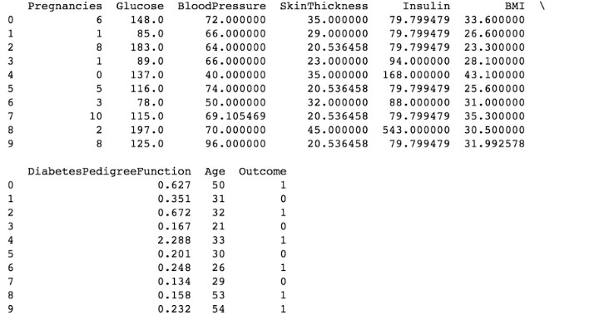
MODELING: USING PYTHON SCIKIT LEARN
 The file containing data set is loaded in pandas.

Slide 18
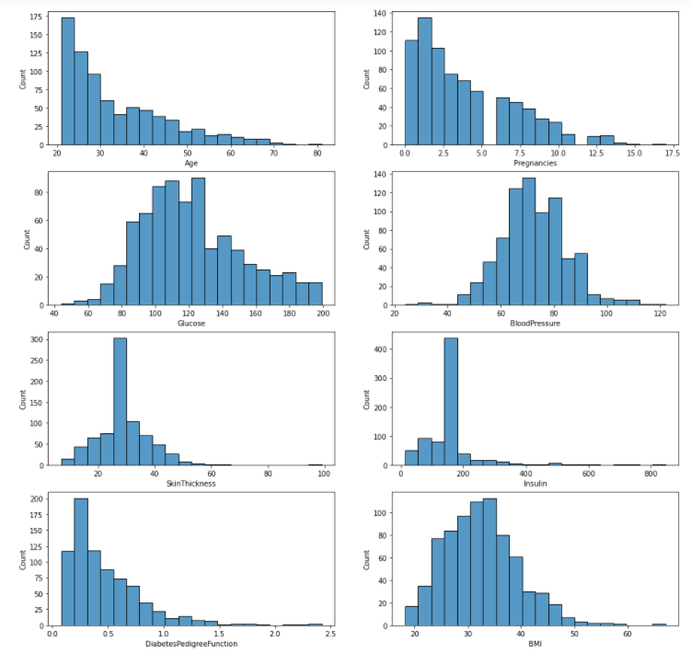
Histograms explaining the variation of count with different attributes mentioned before

Slide 19
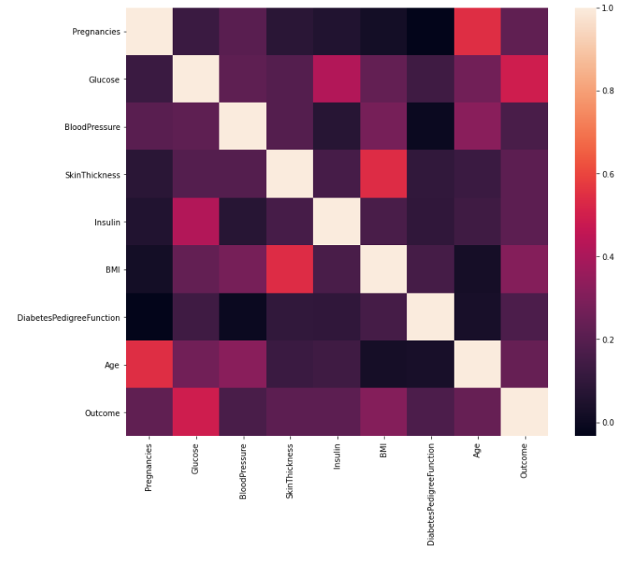
Heatmap (using seaborn) explaining how each attribute is related to the other

Slide 20
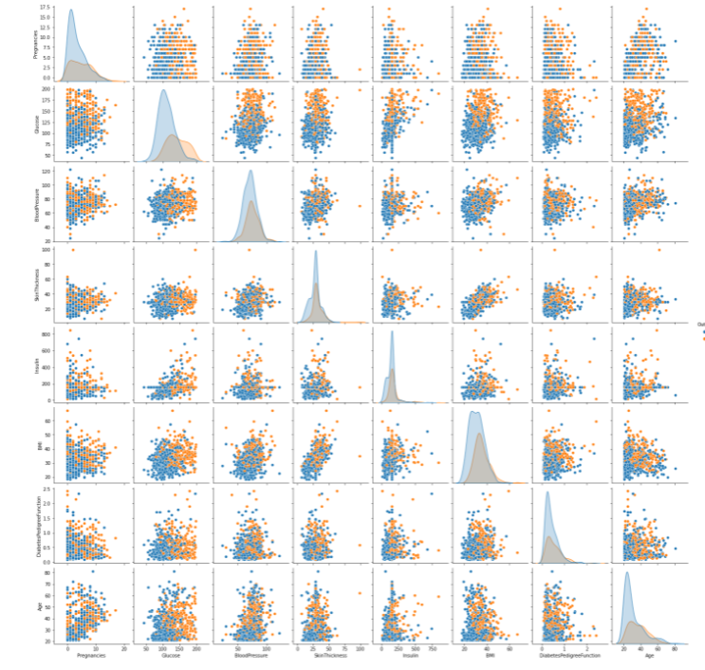
Graphs explaining the relationship between each of the parameters

Slide 21
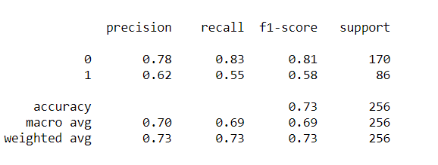
EVALUATION
CONFUSION MATRIX
true positives (TP): These are cases in which we correctly predicted diabetes as result.
true negatives (TN): We correctly predicted no diabetes and they don't have the disease.
false positives (FP): We correctly predicted no diabetes, but they actually had the disease. (Also known as a "Type I error.")
false negatives (FN): We correctly predicted diabetes, but they actually had no disease. (Also known as a "Type II error.")
 | Predicted Yes | Predicted No
Actual Yes | tp (true positive) | fp (false positive)
Actual No | fn (false negative) | tn (true negative)
Confusion Matrix for KNN
Accuracy = tp + tn
tp+tn+fp+fn Precision = tp
tp+fp
Recall = tp
tp+fn
 | Predicted Diabetes | Predicted No Diabetes
Actual Diabetes | 141 | 29
Actual No Diabetes | 39 | 47
The Accuracy for KNN is 73%

Slide 22
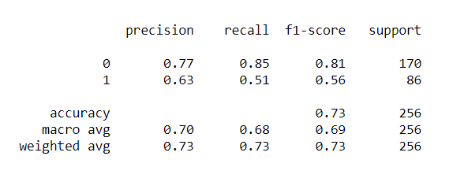
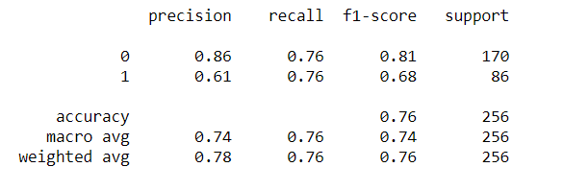
ALTERNATE MODEL COMPARISON
We tried alternate algorithms to compare the accuracy of the model.
We used Random Forest Classifier and Artificial Neural Network. The results obtained are as under:
Confusion Matrix Random Forest Classifier
Confusion Matrix ANN
 | Predicted Diabetes | Predicted No Diabetes
Actual Diabetes | 145 | 25
Actual No Diabetes | 42 | 44
 | Predicted Diabetes | Predicted No Diabetes
Actual Diabetes | 145 | 25
Actual No Diabetes | 34 | 52
The Accuracy of Random Forest Classifier Model is 73%
The Accuracy of ANN is 76%.

Slide 23
DEPLOYMENT
This is the last and the final phase of CRISP DM process. Deployment includes three important task :
Plan Deployment – Planning basically includes the strategy to be formulated for implementing the model in real world. This model can now be used in medical organizations for easy and early detection of diabetes in patients.
Monitor Deployment – In this, continuous monitoring of model takes place.
Regular check is done to ensure model is working fine and if any error occurs can be easily detected.
Generate Reports – Final statistical reports are generated which summarizes
the overall performance of the model.

Slide 24
CONCLUSION
The ANN model achieved 76% accuracy after various hyperparameter tunings which is the highest accuracy compared to KNN and Random Forest Classifier’s 73%
For the other 2 models different options were taken into consideration to improve the accuracy.
In KNN we chose the number of neighbors as 17 which provided the best accuracy
and similarly in Random Forest Classifier we chose the number of estimators = 10

Slide 25
REFERENCE
https://www.kaggle.com/uciml/pima-indians-diabetes-database
Slides & Lecture Notes
http://scikit-learn.org/stable/
http://pandas.pydata.org/

Slide 26
THANK YOU
My Github : Please Click Here
My LinkedIn : Please Click Here

